Slide 1
501(c) Groups and Subgroups
Community and Societal Benefit
Mutual Membership Benefit
General
Corporation
3 – Regular Nonprofits
4 – Civic Leagues, Social Welfare Organizations, and Local Associations of Employees
6 – Business Leagues, Chambers of Commerce, Real Estate Boards
13 – Cemetery Companies
501k – Childcare Organizations
1 – Corporations Organized Under Act of Congress Federal Credit
2 – Title Holding Corporations for Exempt Organizations, Unions, and National Farm Assoc.
25 – Real Property Title-Holding Corporations or Trusts with Multiple Parents
Insurance
Political
9 – Voluntary Employee Beneficiary Associations
12 – Benevolent Life Insurance Associations, Mutual Ditch or Irrigation Companies, Mutual or Cooperative Telephone Companies, and Like Organizations
15 – Mutual Insurance Companies or Associations
17 - Supplemental Unemployment Benefit Trusts
21 – Black Lung Benefit Trusts
22 – Withdrawal Liability Payment Fund
26 – State-Sponsored Organization Providing Health Coverage for High-Risk Individuals
27 – State-Sponsored Workers’ Compensation Reinsurance Organization
29 – Qualified Nonprofit Health Insurance Issuers
4 – Civic Leagues, Social Welfare Organizations, and Local Associations of Employees
527 – Political Organizations
Community Ownership and Cooperative Operation
14 – State-Chartered Credit Unitions, Mutual Reserve Funds
16 – Cooperative Organizations to Finance Crop Operations
501(e) – Cooperative Hospital Service Organizations
501(f) – Cooperative Service Organizations of Operating Educational Organizations
501(n) – Charitable Risk Pools
521- Farmer Coops
Pension/Retirement/Incentivized Savings
11 – Teachers' Retirement Fund Associations
18 – Employee Funded Pension Trust (created before June 25, 1959)
28 – National Railroad Retirement Investment Trust
529 Plan – Qualified State-Sponsored Tuition Programs
Membership Association
7 – Social and Recreational Clubs
10 – Domestic Fraternal Societies and Associations
19 – Post or Organization of Past or Present Members of the Armed Forces
501(d) – Religious and Apostolic Associations
Special Interest MMB
5 – Labor, Agricultural and Horticultural Organizations
8 – Fraternal Beneficiary Societies and Associations
23 – Veterans Organizations
Defunct
20 – Group Legal Services Plan Organizations
24 – Section 4049 ERISA Trusts

Slide 2
Government Sponsored
Trust and Grantmaking
Membership
1 – corporations organized under act of of congress federal credit unions and national farm assoc.
21 - Black Lung Benefit Trusts
Membership Communities
24 - Section 4049 ERISA Trusts
7- Social and Recreational Clubs
25 - Real Property Title-Holding Corporations or Trusts with Multiple Parents
27 - State-Sponsored Workers' Compensation Reinsurance Organization
10 - Domestic Fraternal Societies and Associations
19 - Post or Organization of Past or Present Members of the Armed Forces
26 - State-Sponsored Organization Providing Health Coverage for High-Risk Individuals
2- title holding corporations for exempt organizations
14 - State-Chartered Credit Unions, Mutual Reserve Funds
Mutual Membership Benefit ( such as Insurance and Retirement Funds)
5 - Labor, Agricultural and Horticultural Organizations
17 - Supplemental Unemployment Benefit Trusts
529 plan – qualified state-sponsored tuition programs
8 - Fraternal Beneficiary Societies and Associations
18.- Employee Funded Pension Trust (created before June 25, 1959)
9 - Voluntary Employee Beneficiary Associations
20 - Group Legal Services Plan Organizations
11 - teachers' Retirement Fund Associations
22 - Withdrawal Liability Payment Fund
12 - Benevolent Life Insurance Associations, Mutual Ditch or Irrigation Companies, Mutual or Cooperative Telephone Companies, and Like Organizations
28 - National Railroad Retirement Investment Trust
29 - Qualified Nonprofit Health Insurance Issuers
13 - Cemetery Companies
23 - Veterans Organizations^{[c}
Cooperative or Community Ownership
16 - Cooperative Organizations to Finance Crop Operations
Societal Benefit
3 – regular nonprofits
Political Organizations
501(d) – Religious and apostolic associations
501(e) – Cooperative hospital service organizations
6- Business Leagues, Chambers of Commerce, Real Estate Boards
527 – political organizations
501(f) – Cooperative service organizations of operating educational organizations
4 - Civic Leagues, Social Welfare Organizations, and Local Associations of Employees
501(n) – Charitable risk pools
15 - Mutual Insurance Companies or Associations

Slide 3
Community and Societal Benefit
Mutual Membership Benefit
General
Corporation
3 – regular nonprofits
13 - Cemetery Companies
1 – corporations organized under act of of congress federal credit unions and national farm assoc.
25 - Real Property Title-Holding Corporations or Trusts with Multiple Parents
2- title holding corporations for exempt organizations
4 - Civic Leagues, Social Welfare Organizations, and Local Associations of Employees
501k – Child care orgs
Insurance
6- Business Leagues, Chambers of Commerce, Real Estate Boards
27 - State-Sponsored Workers' Compensation Reinsurance Organization
22 - Withdrawal Liability Payment Fund
Political
527 – political organizations
26 - State-Sponsored Organization Providing Health Coverage for High-Risk Individuals
29 - Qualified Nonprofit Health Insurance Issuers
4 - Civic Leagues, Social Welfare Organizations, and Local Associations of Employees
21 - Black Lung Benefit Trusts
12 - Benevolent Life Insurance Associations, Mutual Ditch or Irrigation Companies, Mutual or Cooperative Telephone Companies, and Like Organizations
9 - Voluntary Employee Beneficiary Associations
Community Ownership and Cooperative Operation
15 - Mutual Insurance Companies or Associations
16 - Cooperative Organizations to Finance Crop Operations
17 - Supplemental Unemployment Benefit Trusts
501(e) – Cooperative hospital service organizations
Pension/Retirement/Incentivized Savings
501(f) – Cooperative service organizations of operating educational organizations
529 plan – qualified state-sponsored tuition programs
501(n) – Charitable risk pools
11 - teachers' Retirement Fund Associations
521- farmer coops
14 - State-Chartered Credit Unions, Mutual Reserve Funds
18.- Employee Funded Pension Trust (created before June 25, 1959)
Membership Association
28 - National Railroad Retirement Investment Trust
Defunct
7- Social and Recreational Clubs
24 - Section 4049 ERISA Trusts
10 - Domestic Fraternal Societies and Associations
20 - Group Legal Services Plan Organizations
Special Interest MMB
19 - Post or Organization of Past or Present Members of the Armed Forces
23 - Veterans Organizations^{[c}
8 - Fraternal Beneficiary Societies and Associations
501(d) – Religious and apostolic associations
5 - Labor, Agricultural and Horticultural Organizations

Slide 4
Cross Tabs with Urban’s BMF

Slide 5
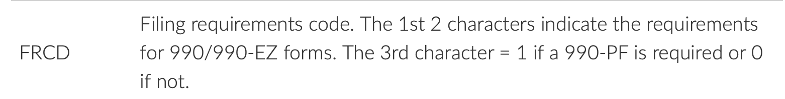
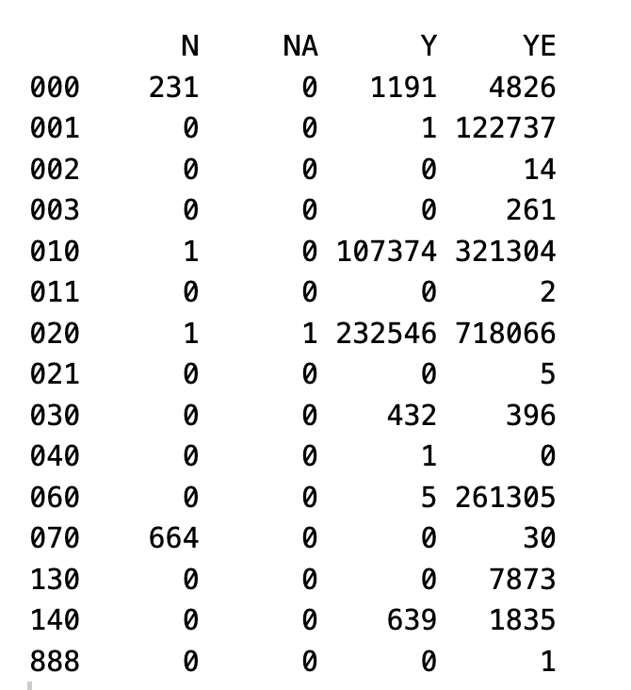
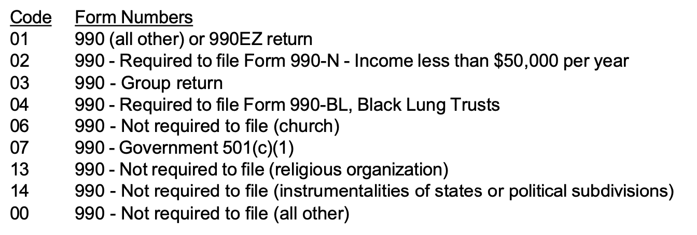
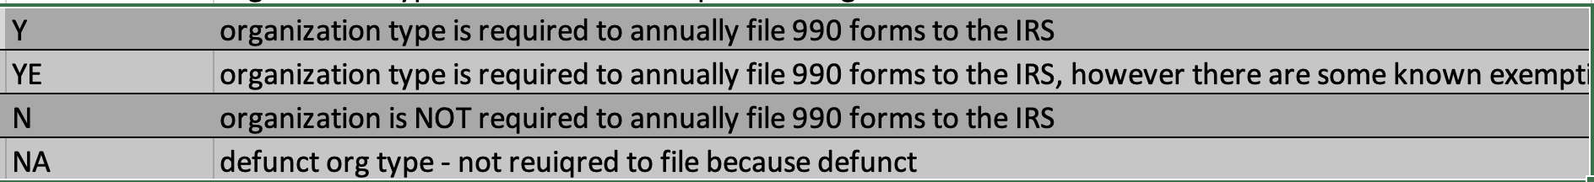
BMF: FRCD vs Ours: Required_990
Bmf: FRCD
Ours: Required_990
Red box is where our codes should be
Conclusion: Most of these are classified as they should be

Slide 6

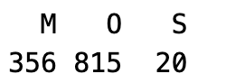
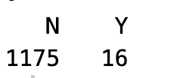
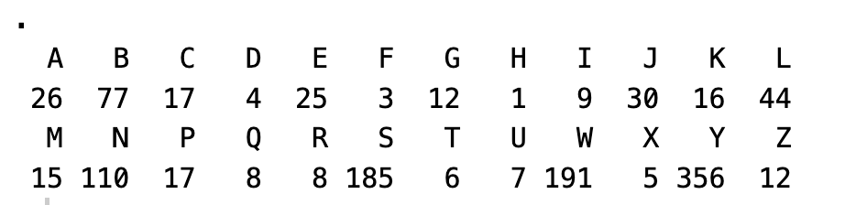
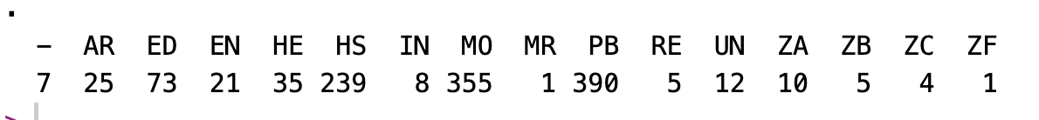
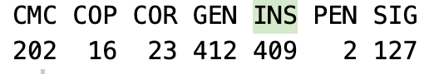
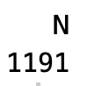
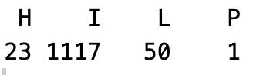
BMF: FRCD vs Ours: Required_990
Level 2:
Level 1:
SUBSECCD:
Filer:
NTEE1:
Level3:
Tax_exempt_subgroup:
Govt_established:
Supporting:
Red box is where our codes should be

Slide 7
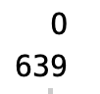
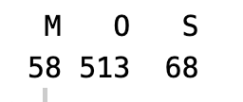
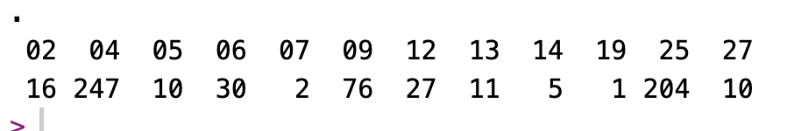
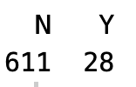
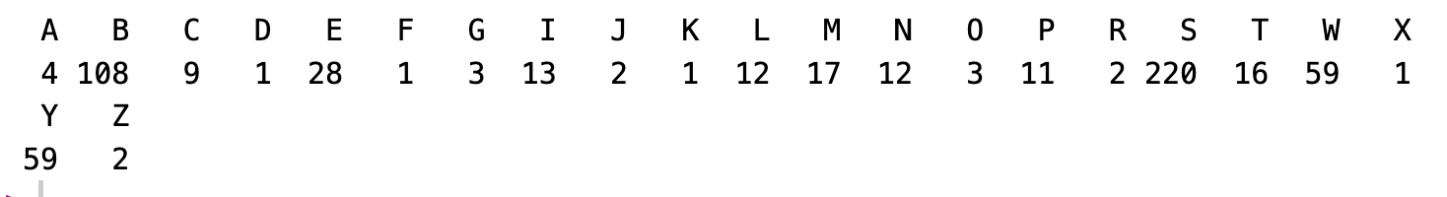
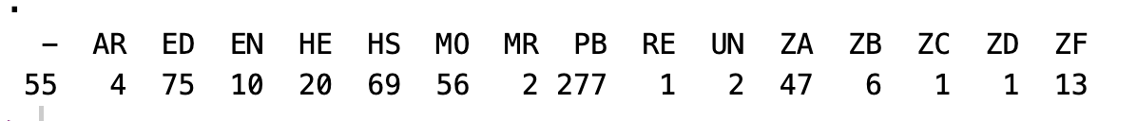
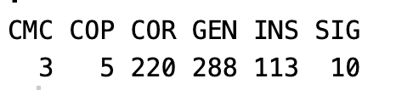
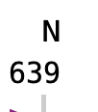
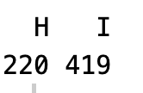
BMF: FRCD vs Ours: Required_990
Level 1:
Level 2:
SUBSECCD:
Filer:
NTEE1:
Level3:
Tax_exempt_subgroup:
Govt_established:
Supporting:
Red box is where our codes should be

Slide 8
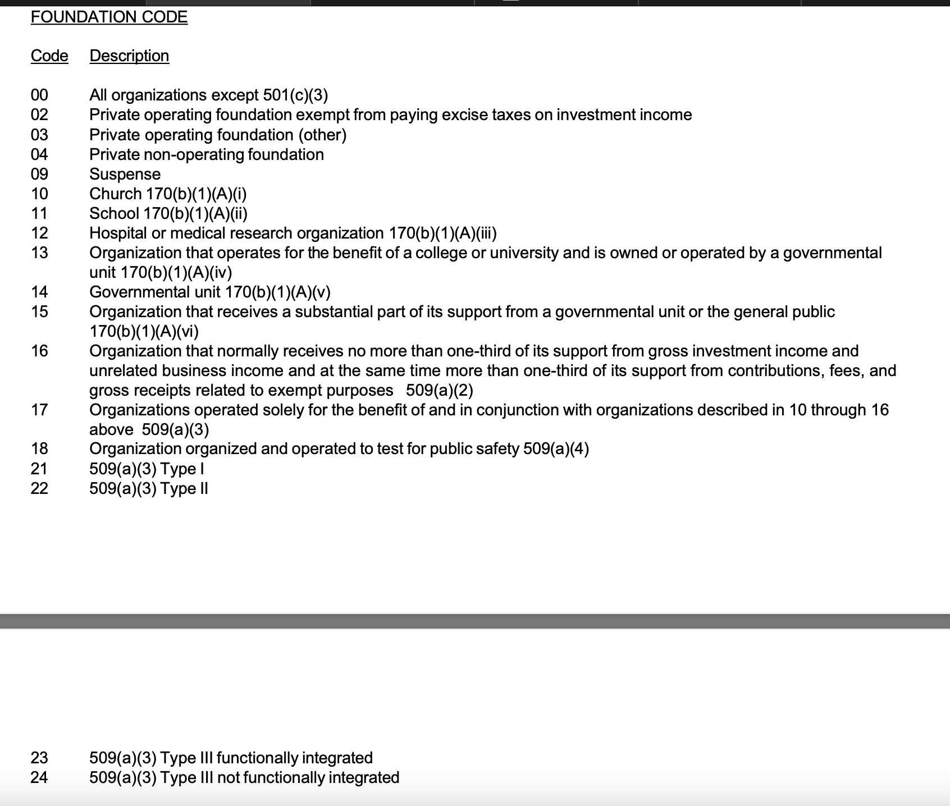
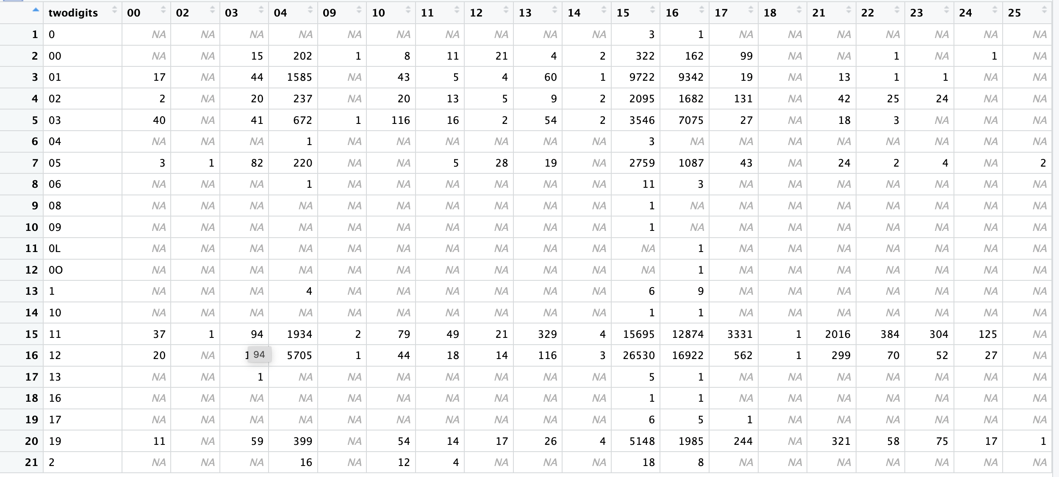
BMF FOUNDATION VS First 2 digits of NTEE
Only looking at first two digits < 20 (since these are the specialty orgs)
= row shouldn’t exist, is likely a typo in the bmf
Notes:
Twodigit == 11 or 12 usually goes to FOUNDATION == 15 or 16. This also seems he be the case for Twodigit == 01,02,03. To me this suggests that foundation code and NTEE digits are not telling the same thing. If they were we would want,
twodigit ==11 be FOUNDATION ==21,
twodigit ==12 be FOUNDATION ==22,
twodigit ==13 be FOUNDATION ==23 or 24,

Slide 9
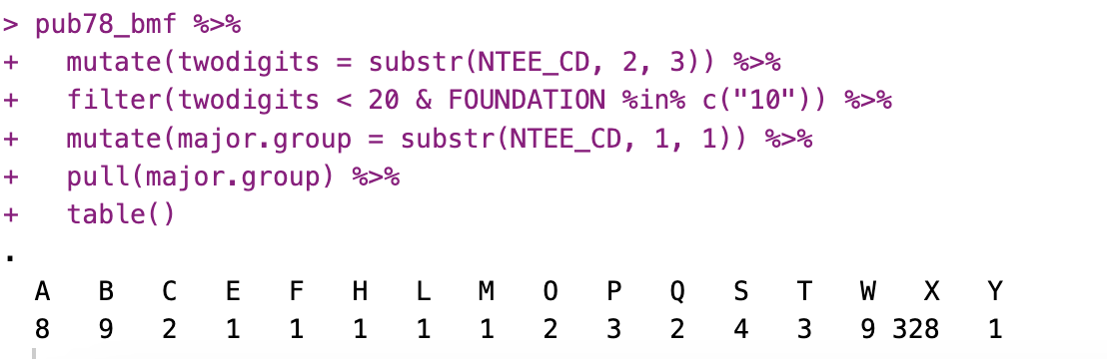
FOUNDATION == “10” & NTEE two digit < 20
X is “religion related” so that makes sense.

Slide 10
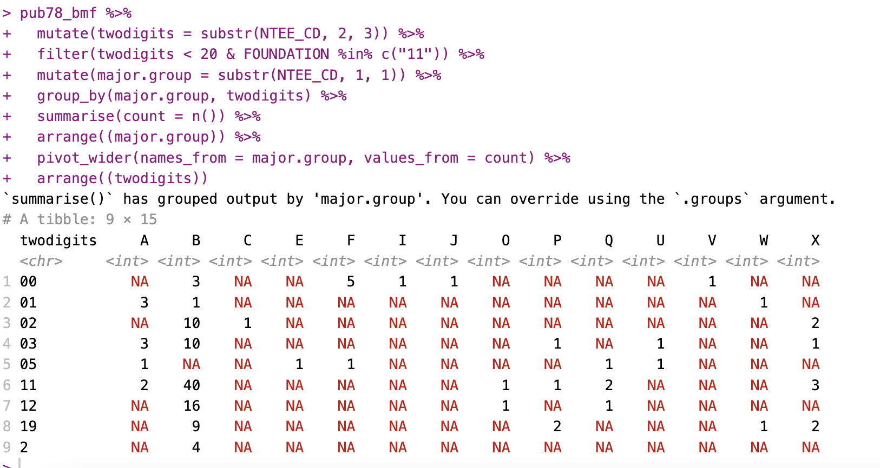
FOUNDATION == “11” & NTEE two digit < 20
Most of these are group B which is good.
However, we would ideally want
twodigit ==11 be FOUNDATION ==21,
twodigit ==12 be FOUNDATION ==22,
twodigit ==13 be FOUNDATION ==23 or 24,

Slide 11
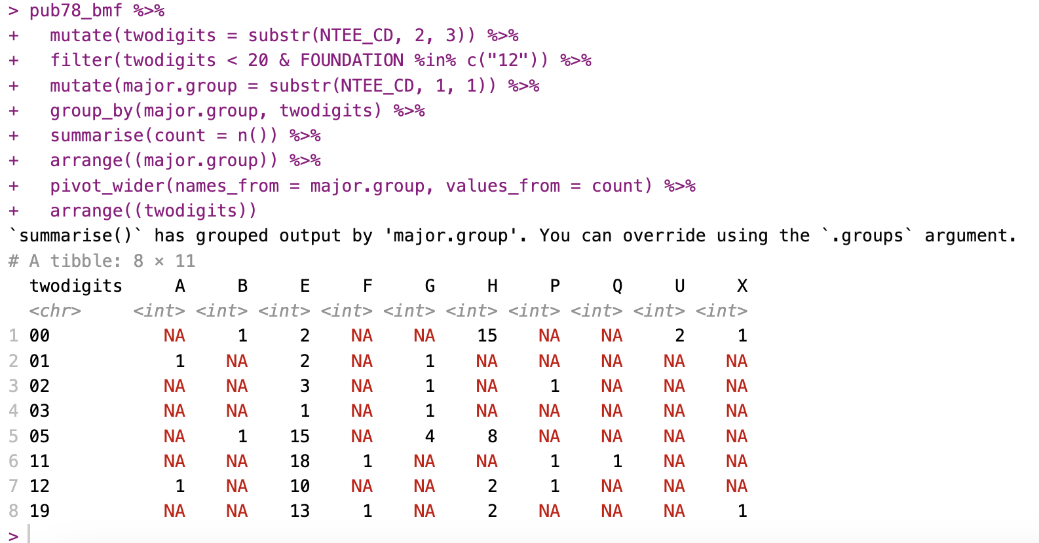
FOUNDATION == “12” & NTEE two digit < 20
Most of these are group E which is good.
However, we would ideally want
twodigit ==11 be FOUNDATION ==21,
twodigit ==12 be FOUNDATION ==22,
twodigit ==13 be FOUNDATION ==23 or 24,

Slide 12
Cross Tabs with IRS’s BMF

Slide 13
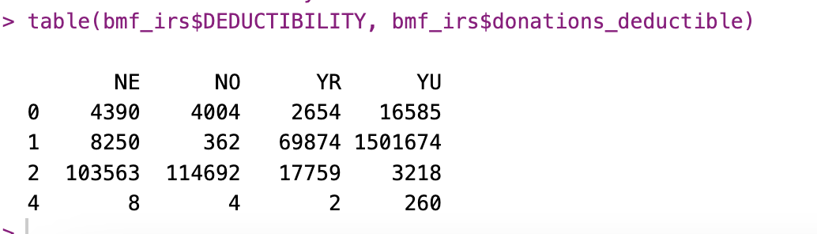
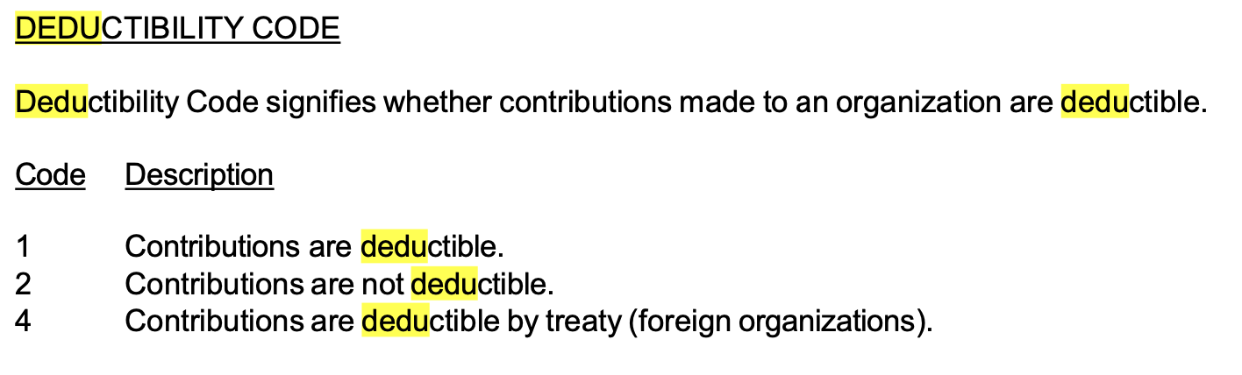
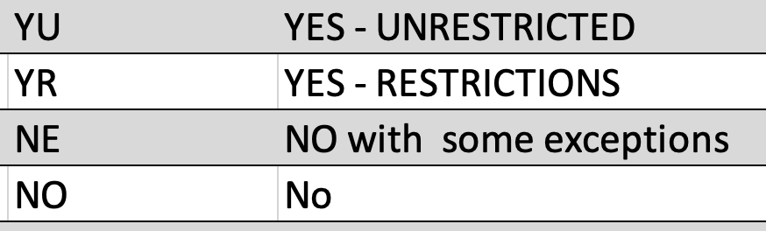
IRSBMF:DEDUCTIBILITY vs. Ours: Donations_deductible
IRS:
Ours:

Slide 14
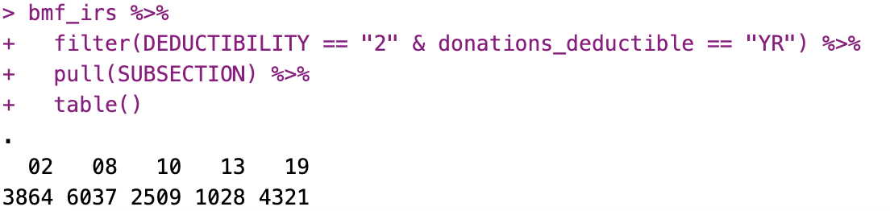
IRSBMF:DEDUCTIBILITY vs. Ours: Donations_deductible
I don’t quite know what to make of this because you definitely can donate to a 501c8, 10.,13, and 19 as long as the funds go to a “charitable purpose”. (501c2 I am less certain on but I think you still technically can).
Maybe the IRS puts “no” and “generally no but there are exceptions” all into category 2.

Slide 15
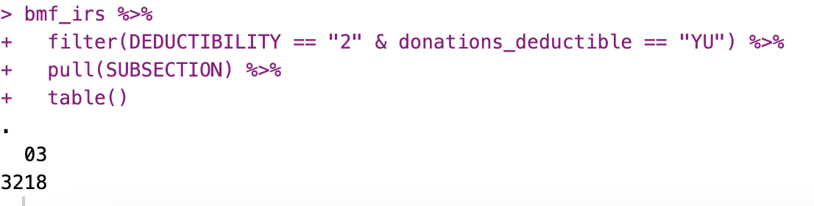
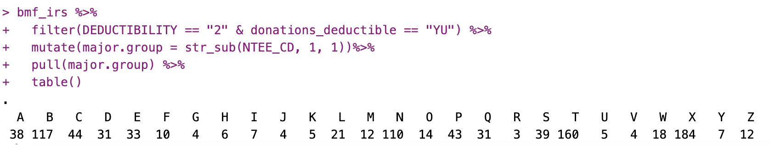
IRSBMF:DEDUCTIBILITY vs. Ours: Donations_deductible
I don’t know why a 501c3 would appear in the “no deductible donations category. Are these orgs with a revocation?

Slide 16
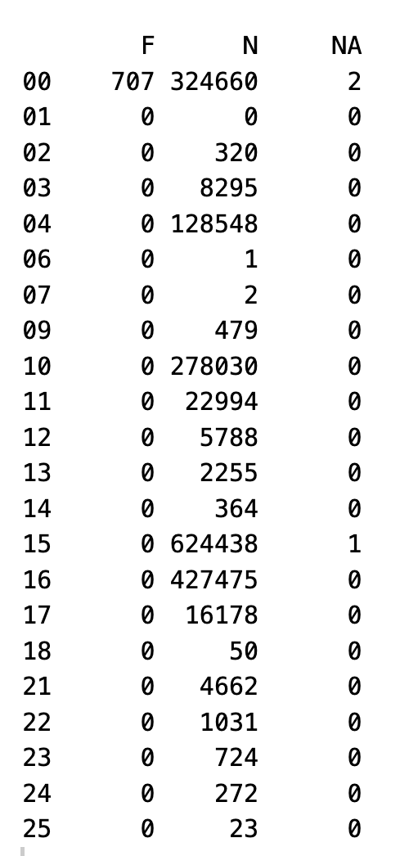
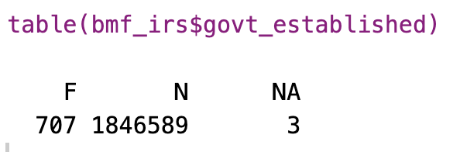
IRSBMF: FOUNDATION vs. Our Govt_Established
This is good. All federally established organizations are non-501c3s

Slide 17
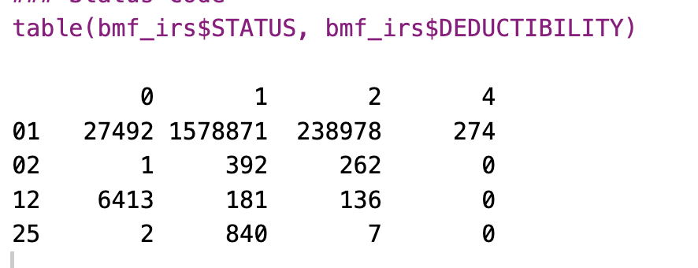
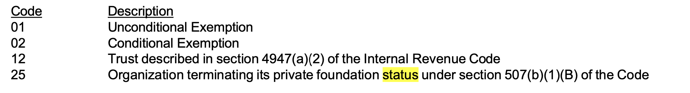
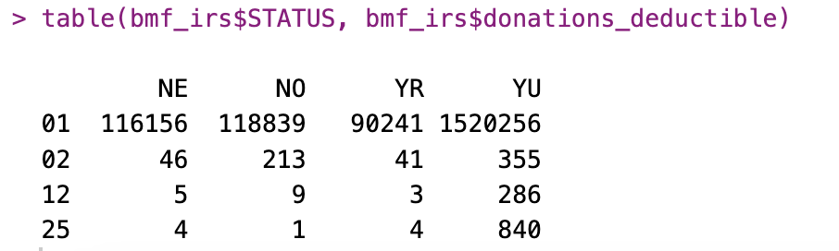
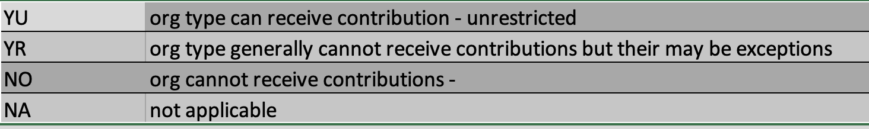
IRS Status & Deductibility vs Our deductible
IRS STATUS
IRS DUDUCTIBILITY
Our Donations_deductible
We can’t verify anything when IRS DEDUCTIBILITY == 0

Slide 18
PUB78

Slide 19
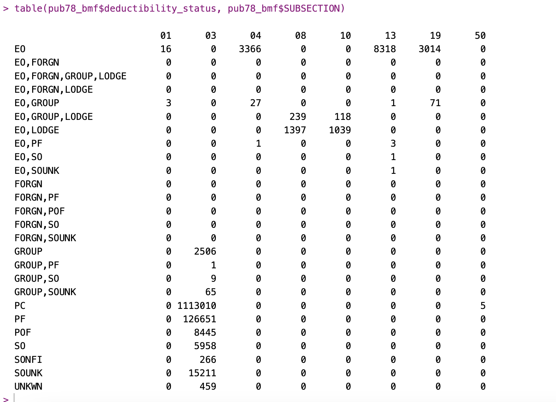
PUB78 Deductibility code vs IRS SUBSECTION

Slide 20
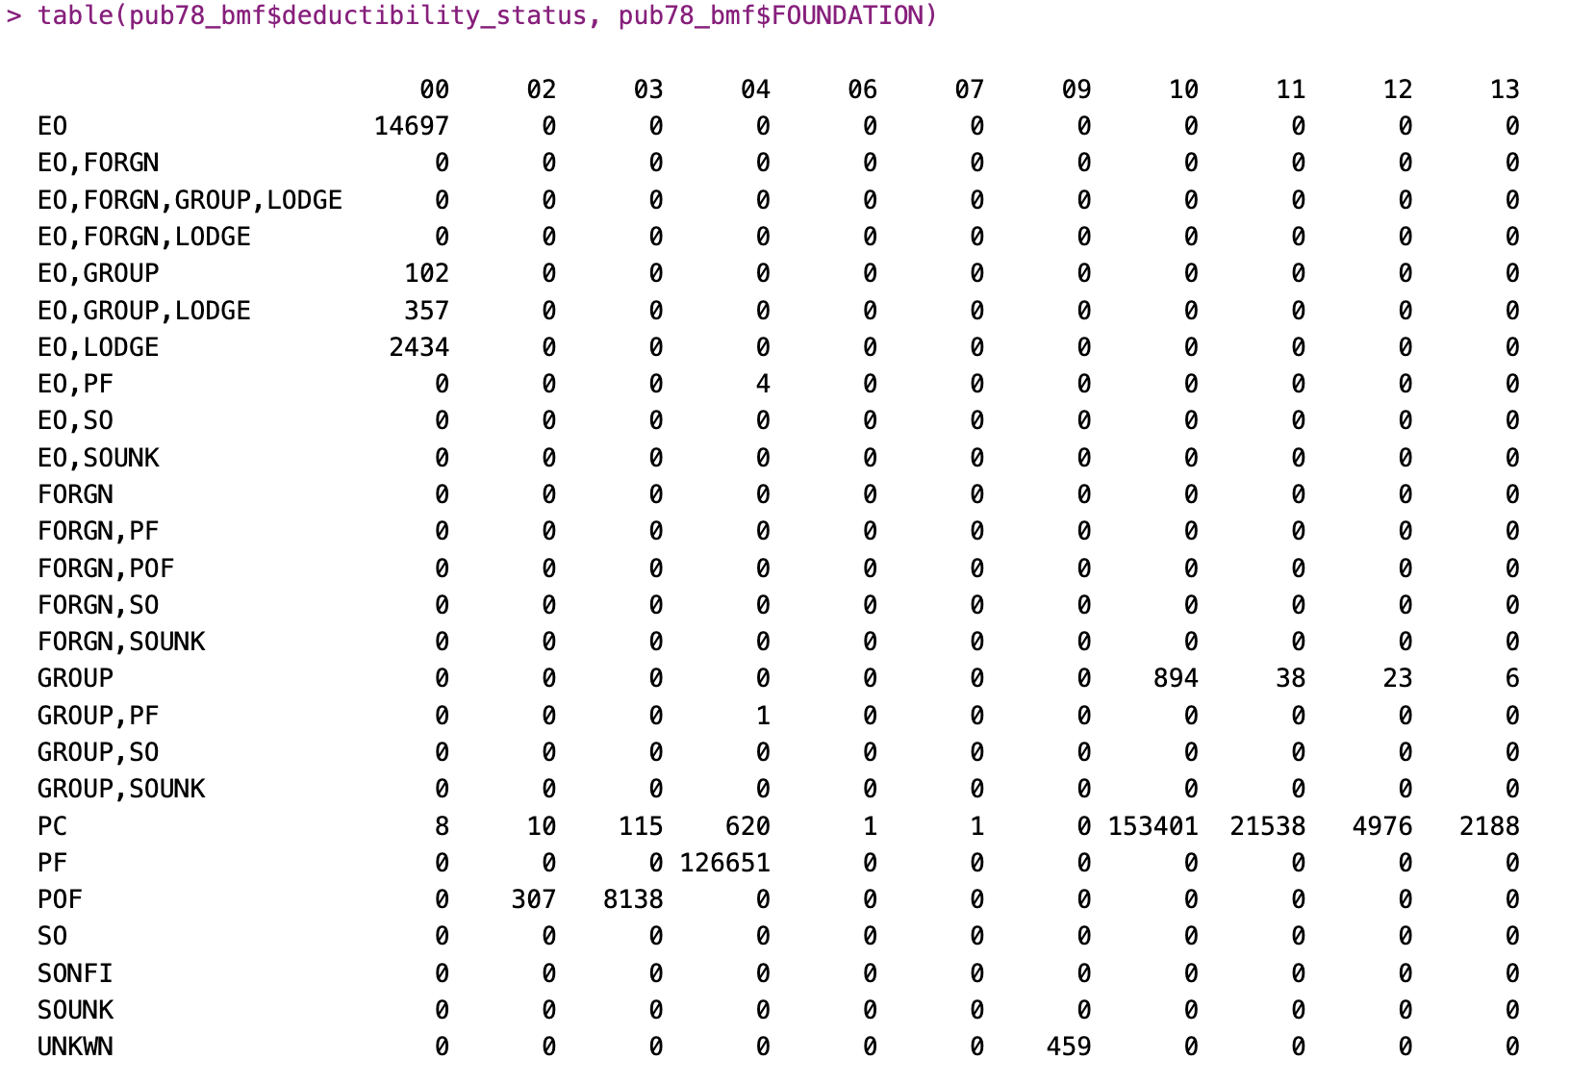
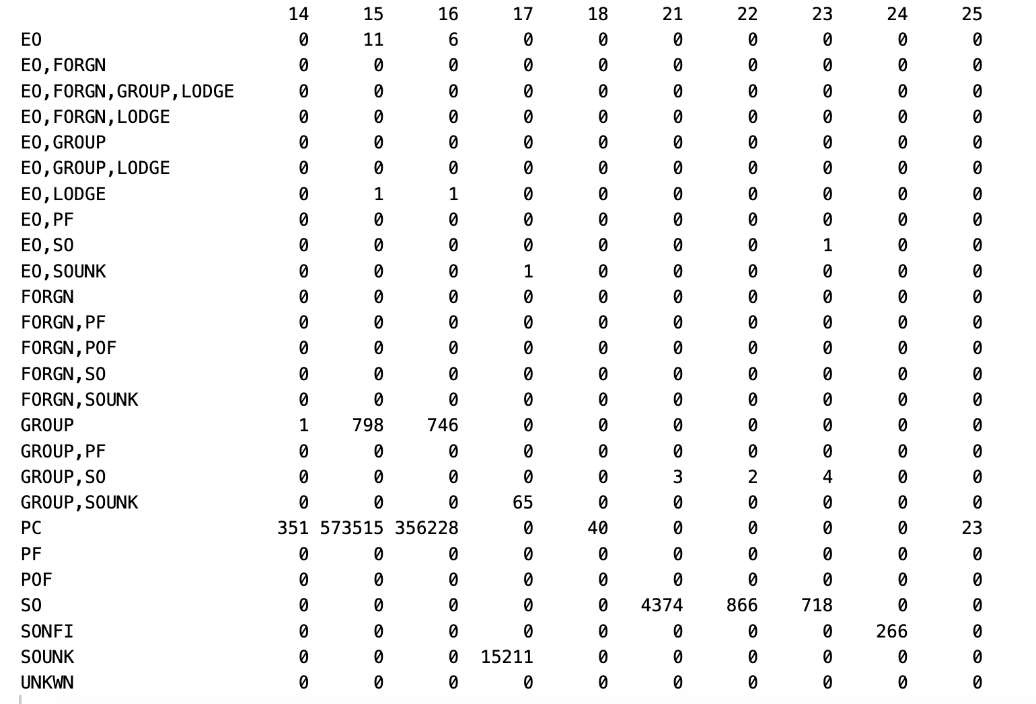
PUB78 DEDUCTIBILITY vs BMF FOUNDATION

Slide 21
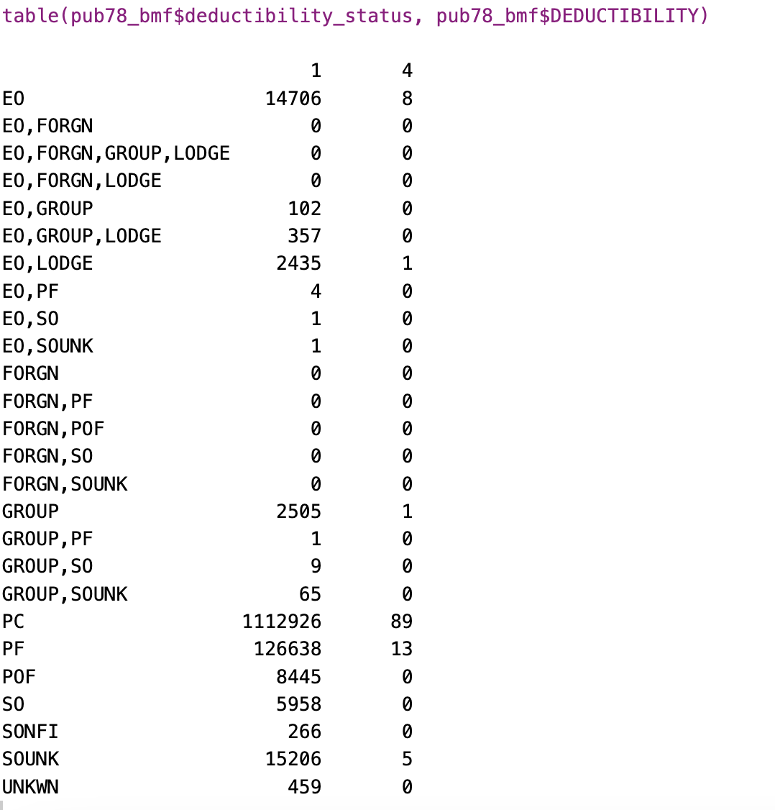
Pub78 deductibility vs IRS deductibility code
These are all organizations listed in the current pub78.
The pub78 data was left joined with the irs bmf.
It is good that there are no 0’s or 2’s in the orgs listed in pub78.

Slide 22
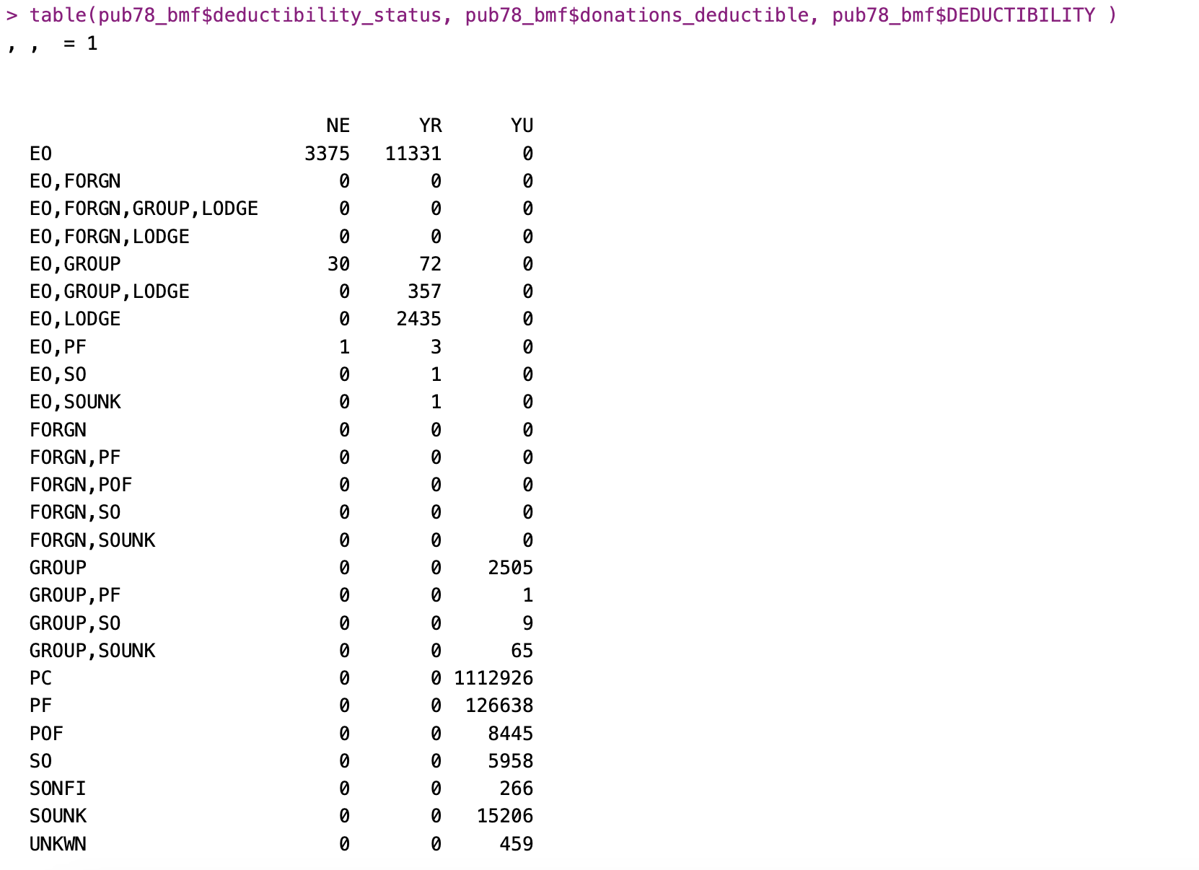
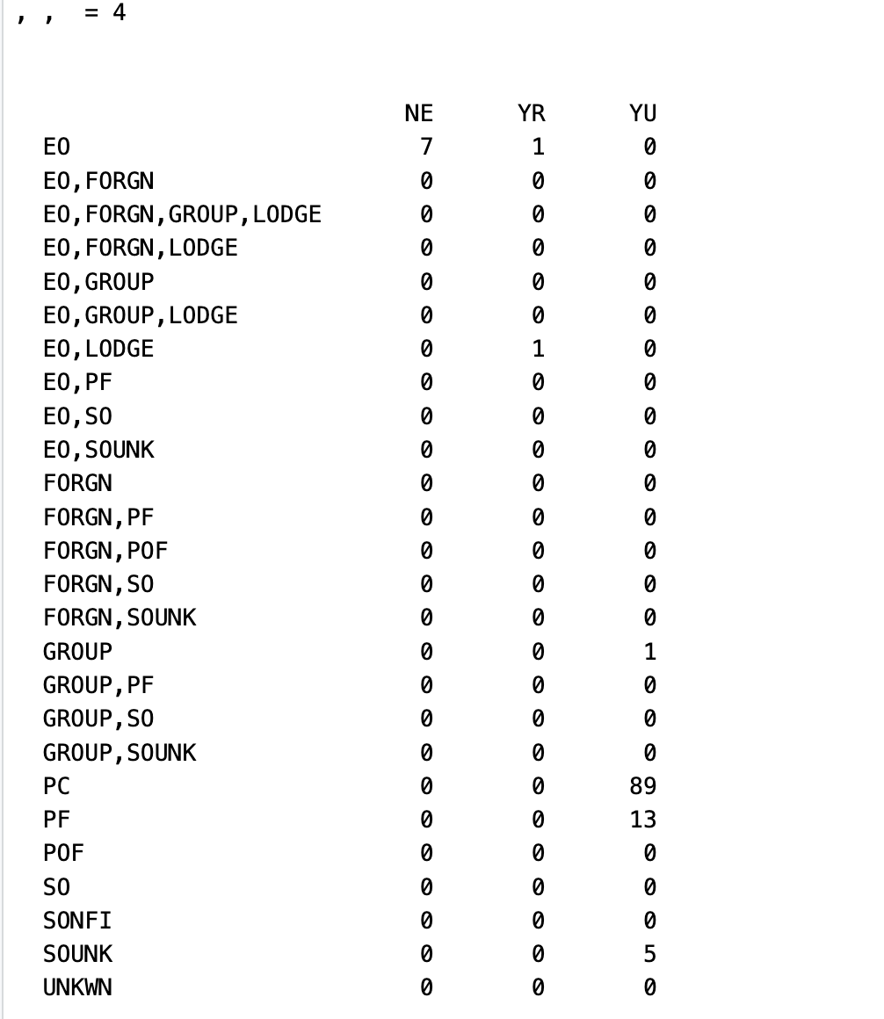
Pub78 deductibility vs IRS deductibility code VS our Donations deductible
Red box is where things should be

Slide 23
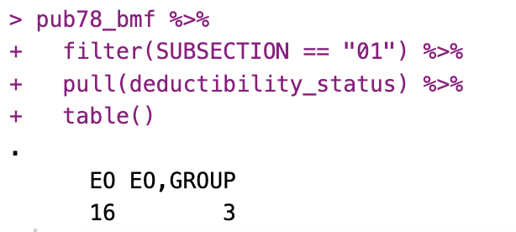
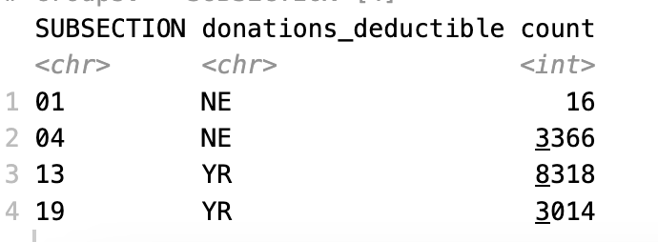
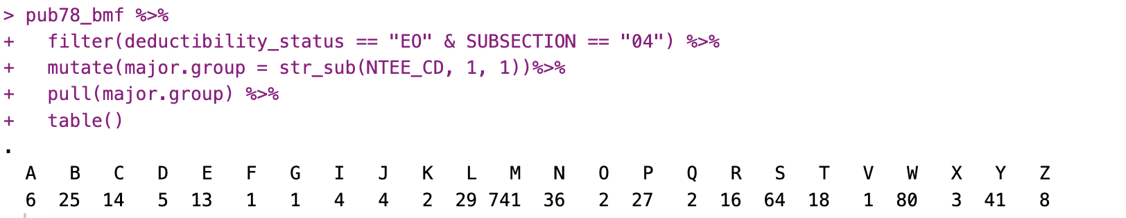
501c1’s usually arent’ EO’s but there are exceptions so this makes sense
Pub78 deductibility vs IRS deductibility code VS our Donations deductible
Red box is where things should be
All 501c13’s are cemeteries
All 501c19’s are veteran’s assoc.
Of the EO 501c4’s most of them are M’s (which will be the fire fighters' associations which are deductible)

Slide 24
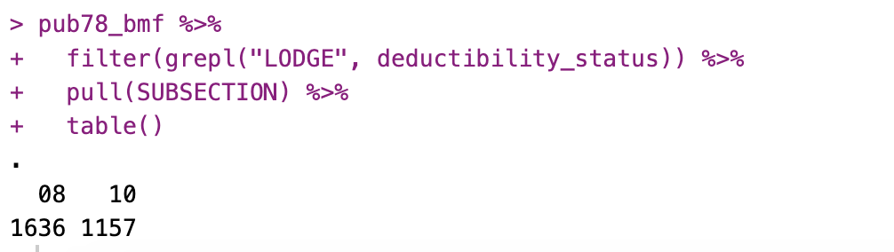
Pub78 deductibility vs IRS deductibility code VS our Donations deductible
Red box is where things should be
Everything with “LODGE” in pub78 is a 501c8 or 10, which are required to be lodges. So this is consistent.

Slide 25
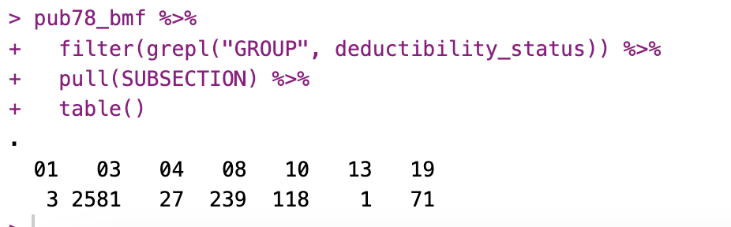
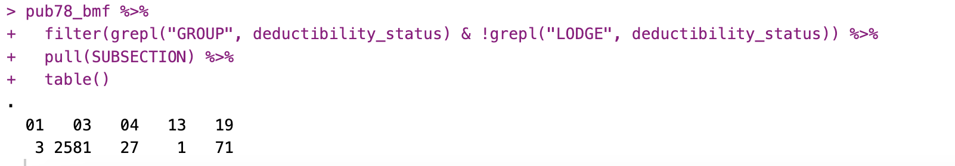
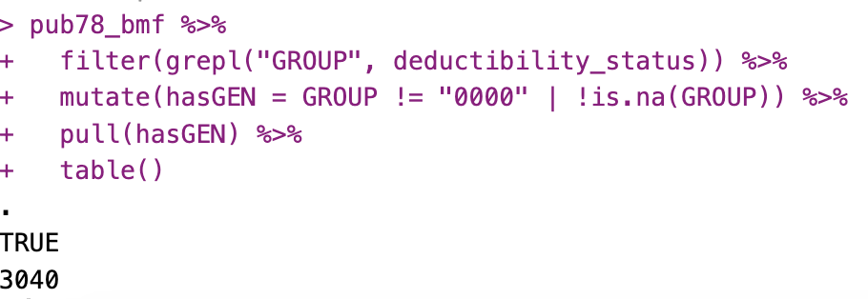

Pub78 deductibility GROUP
Group status in Pub 78:
All GROUP without LODGE is all non 501c8’s and 10’s (which is good)
Everything that is a GROUP in Pub78 has a vail GEN
All of the GEN’s that appear only appear once

Slide 26
OLD

Slide 27

IRSBMF:DEDUCTIBILITY vs. Ours: Donations_deductible
IRS:
Red box is where our codes should be
Ours:
Conclusion: This is good! Most things are classified correctly under our system.

Slide 28







IRSBMF:DEDUCTIBILITY vs. Ours: Donations_deductible
Level 2:
Level 1:
SUBSECTION:
Filer:
Red box is where our codes should be
NTEE1:
Level3:
Tax_exempt_subgroup:
Govt_established:
Supporting:

Slide 29






IRSBMF:DEDUCTIBILITY vs. Ours: Donations_deductible
SUBSECTION:
Filing Requirement:
Red box is where our codes should be
Red box is where our codes should be
NTEE1:
Tax_exempt_subgroup:
Govt_established:
Supporting

Slide 30


We can’t verify anything when IRS DEDUCTIBILITY == 0. Most of the misclassifications are coming from this case.

